Slide 1
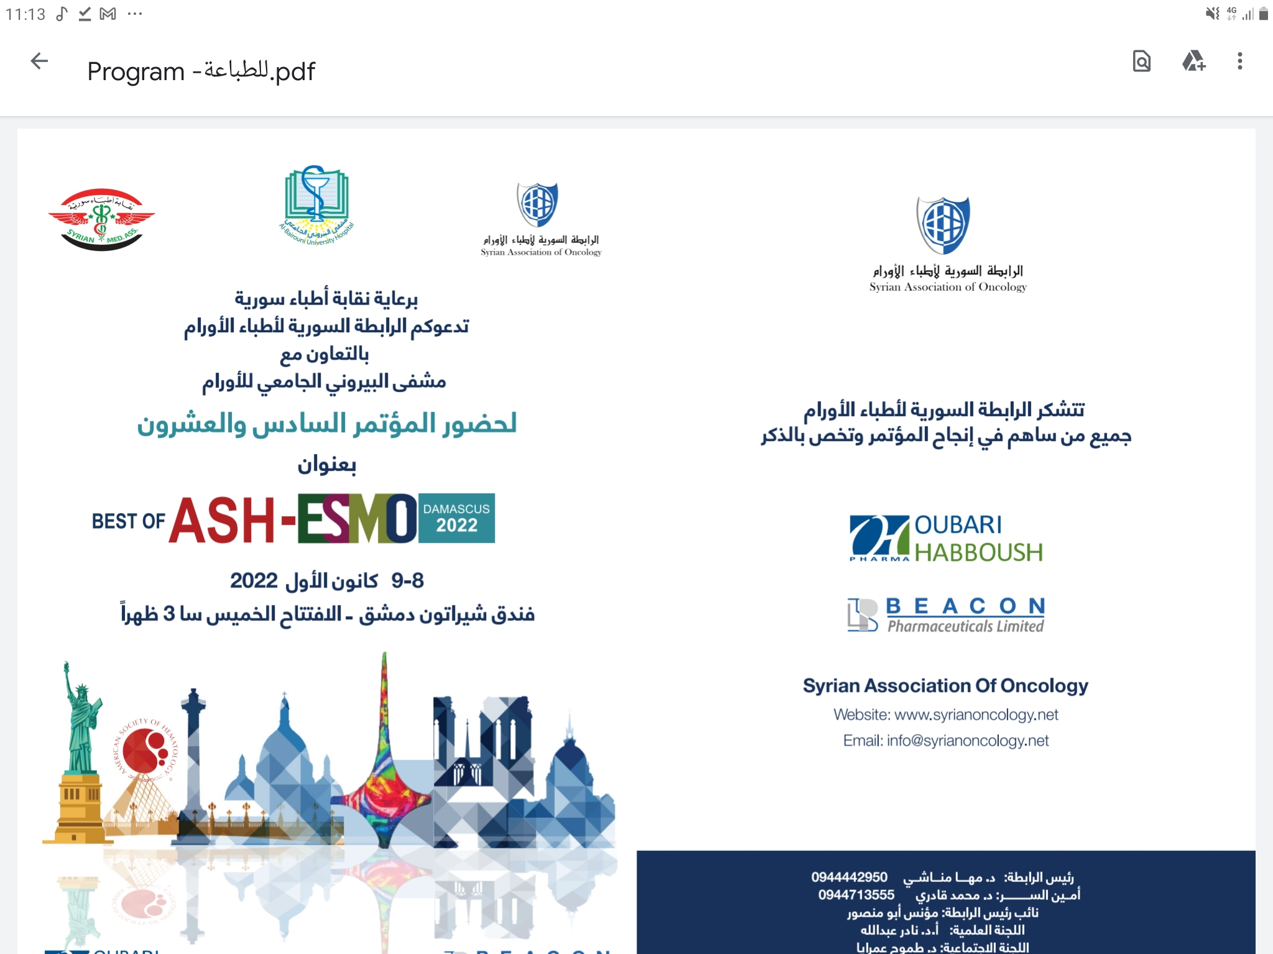



Acute Myeloid Leukemia improving outcomes in challenges subsets
الرابطة السورية لأطباء الأورام
المؤتمر السادس والعشرون
Dr.Soulaiman Elias Soulaiman
Hematologist – Head of BMTU

Slide 2

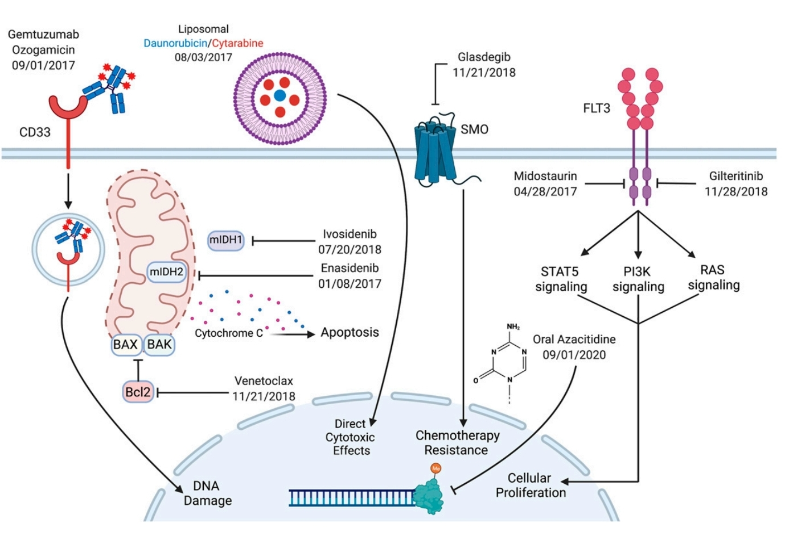
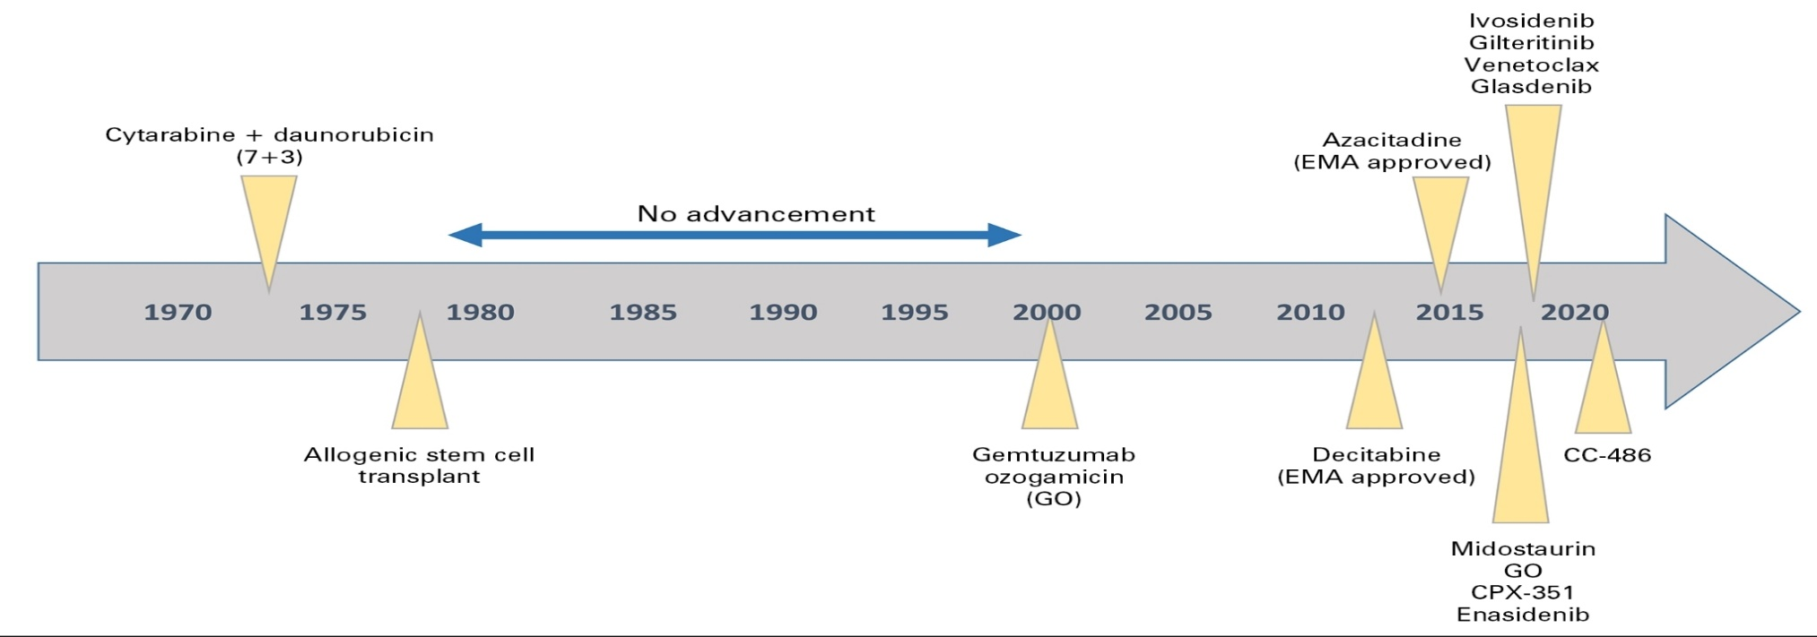
AML: SO MANY OPTIONS, SO LITTLE TIME
Hematology 2021 | ASH Education Program

Slide 3
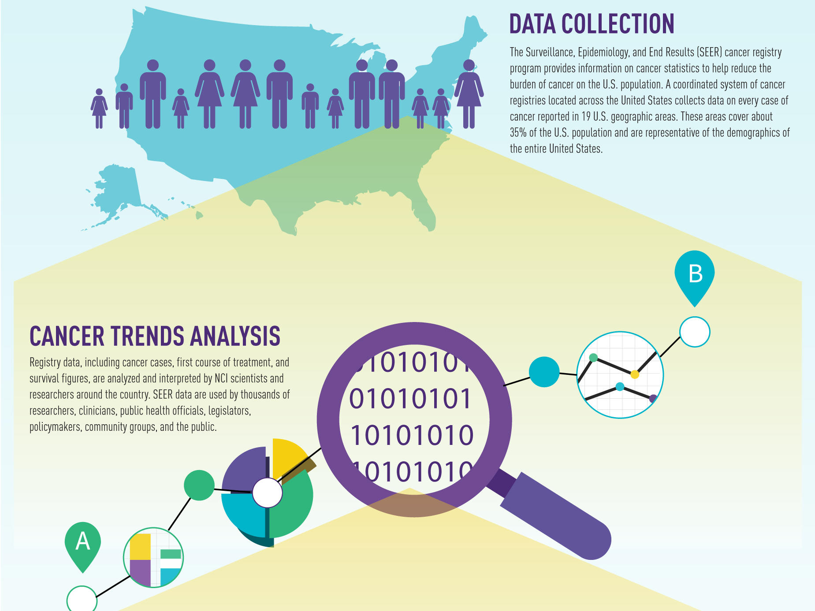


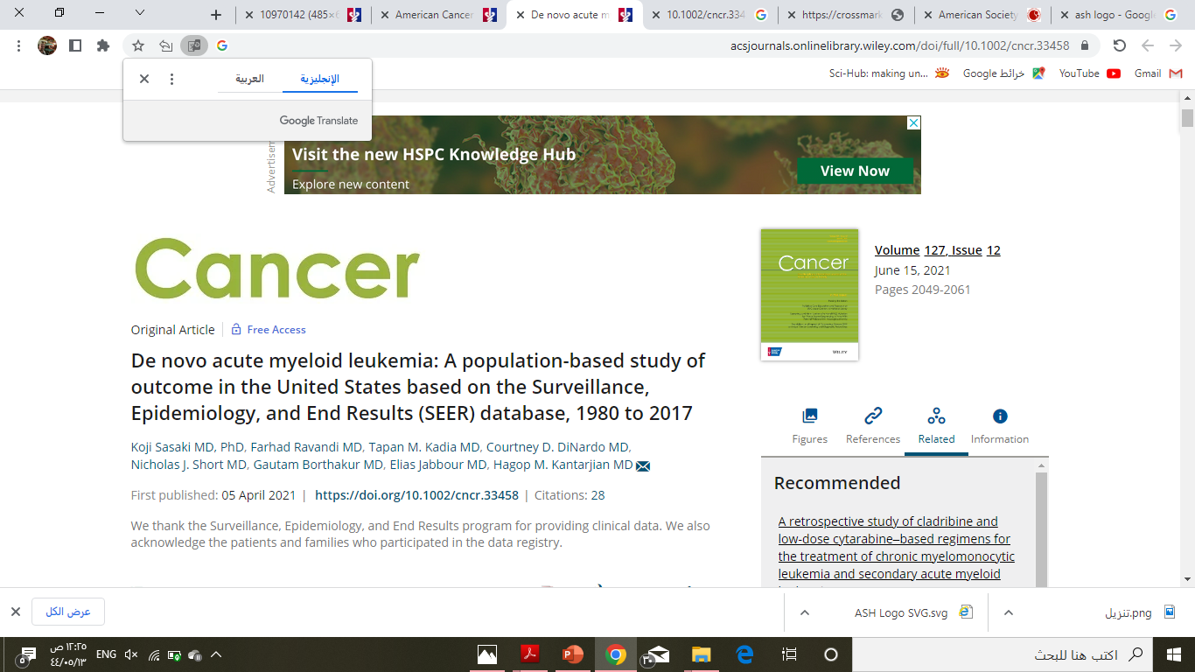
SEER DATABASE

Slide 4
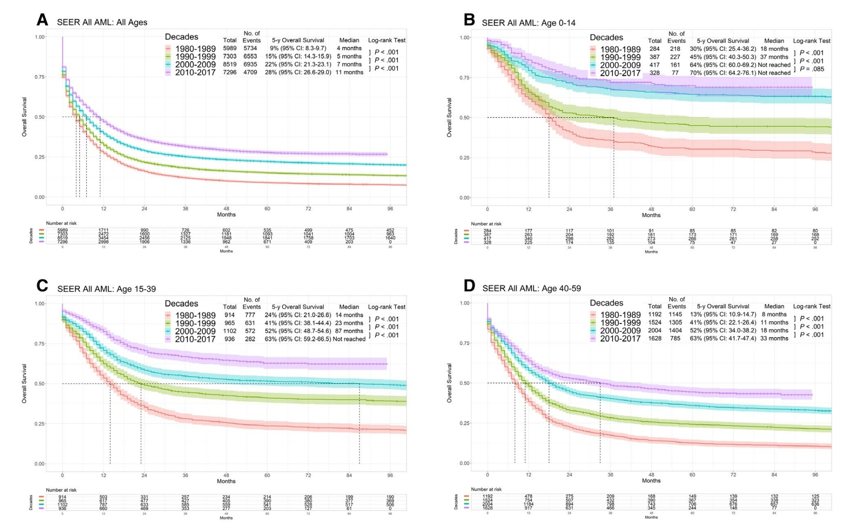
SEER DATABASE

Slide 5
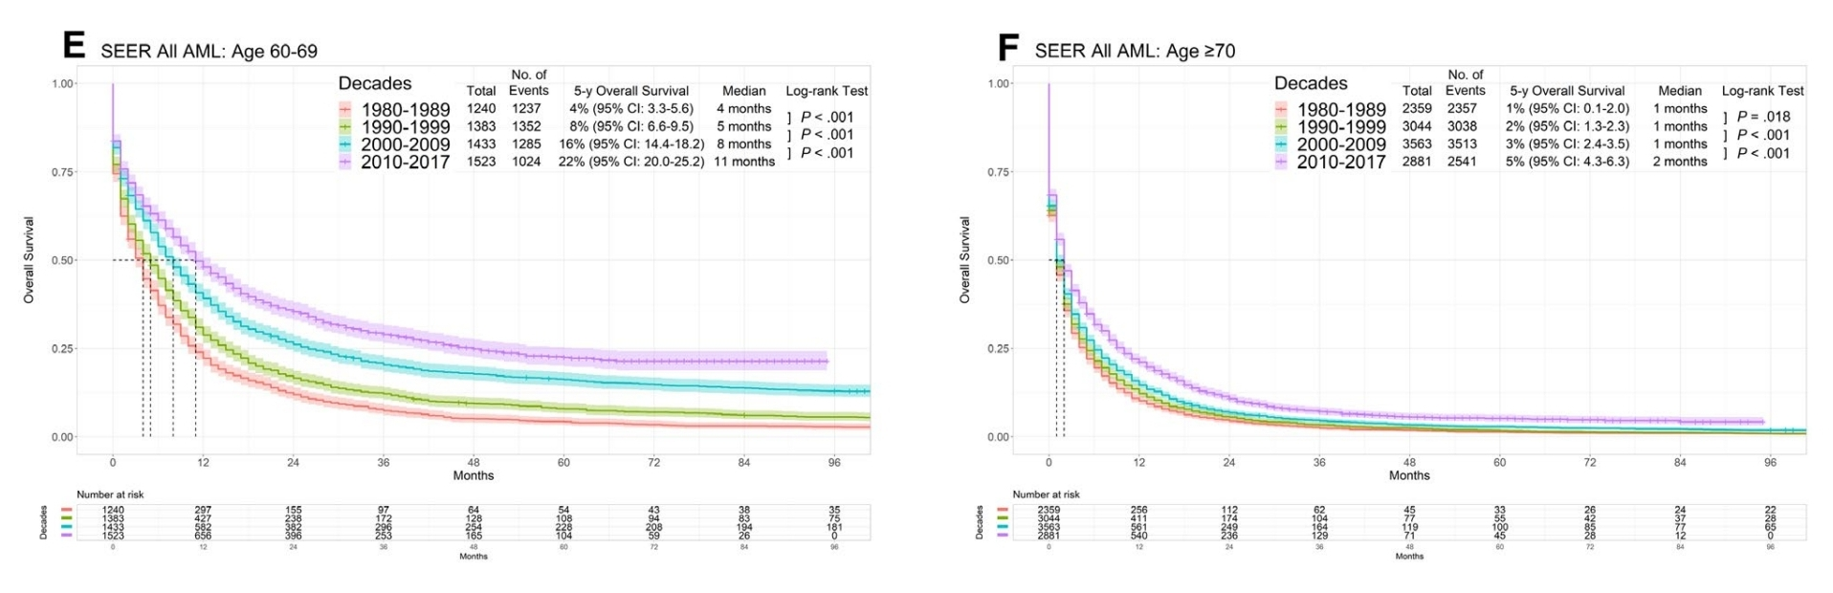
SEER DATABASE

Slide 6
Challenges
New diagnosis (ND) AML: induction therapy challenges
Post-remission therapy challenges
Relapsed/Refractory (R/R) AML therapy

Slide 7
New diagnosis (ND) AML: induction therapy challenges
Unfit patient for intensive chemotherapy
Novel therapeutic agents for fit patient

Slide 8
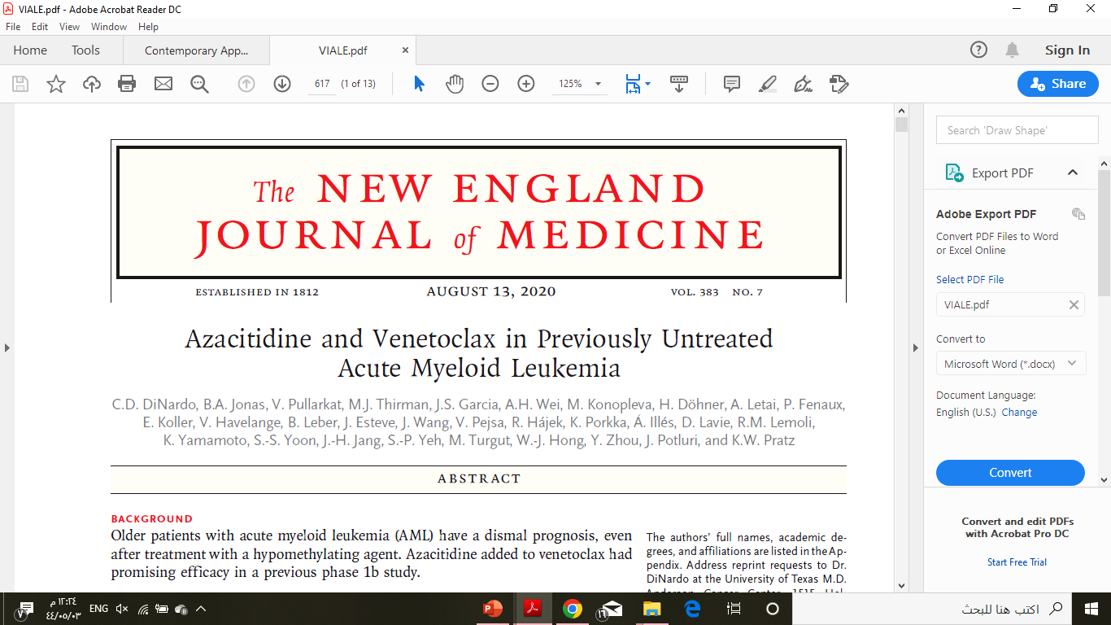
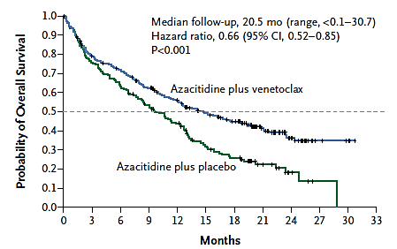
NAÏVE PATIENTS WITH AML WHO ARE INELIGIBLE FOR INTENSIVE CHEMOTHERAPY
LOWER-INTENSITY THERAPIES
VIALE-A trial
CR 36.7%
cCR 66.4%
OS 14.7months
OS 9.6 months
N Engl J Med 2020;383:617-29. DOI: 10.1056/NEJMoa2012971

Slide 9
NAÏVE PATIENTS WITH AML WHO ARE INELIGIBLE FOR INTENSIVE CHEMOTHERAPY
LOWER-INTENSITY THERAPIES
standard treatment approach
VEN-HAM regimens

Slide 10
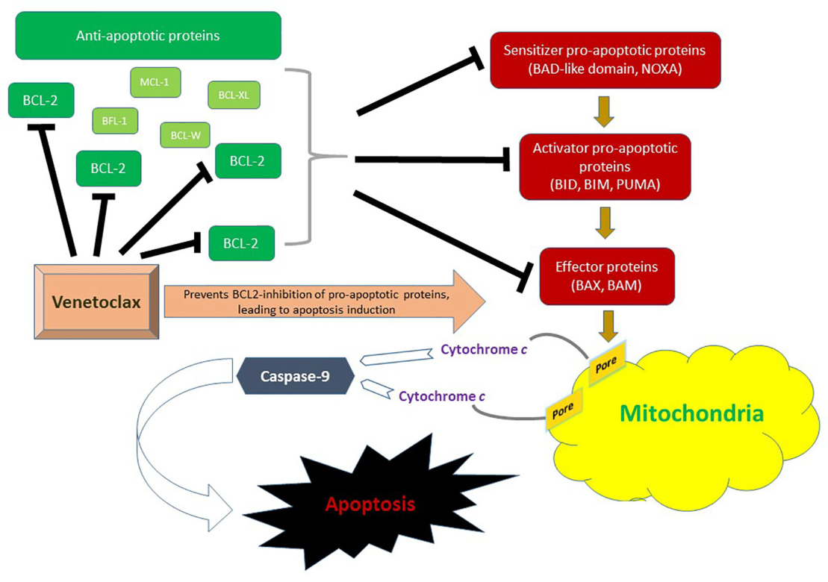
VEN-HAM regimens
The overexpression of BCL-2 in hematologic malignancies has been associated not only with enhanced cell survival and apoptosis evasion, but also with therapy resistance, especially in leukemic stem cells
Synergistic induction of cell death between HMA and BCL-2 inhibitors.
Azacitidine may decrease MCL-1 level which can mediate resistance to BCL-2 inhibitors

Slide 11
NAÏVE PATIENTS WITH AML WHO ARE INELIGIBLE FOR INTENSIVE CHEMOTHERAPY
LOWER-INTENSITY THERAPIES
Certain molecular subsets
TP53-Mutated AML
IDH1/2-Mutated AML
FLT3-Mutated AML

Slide 12
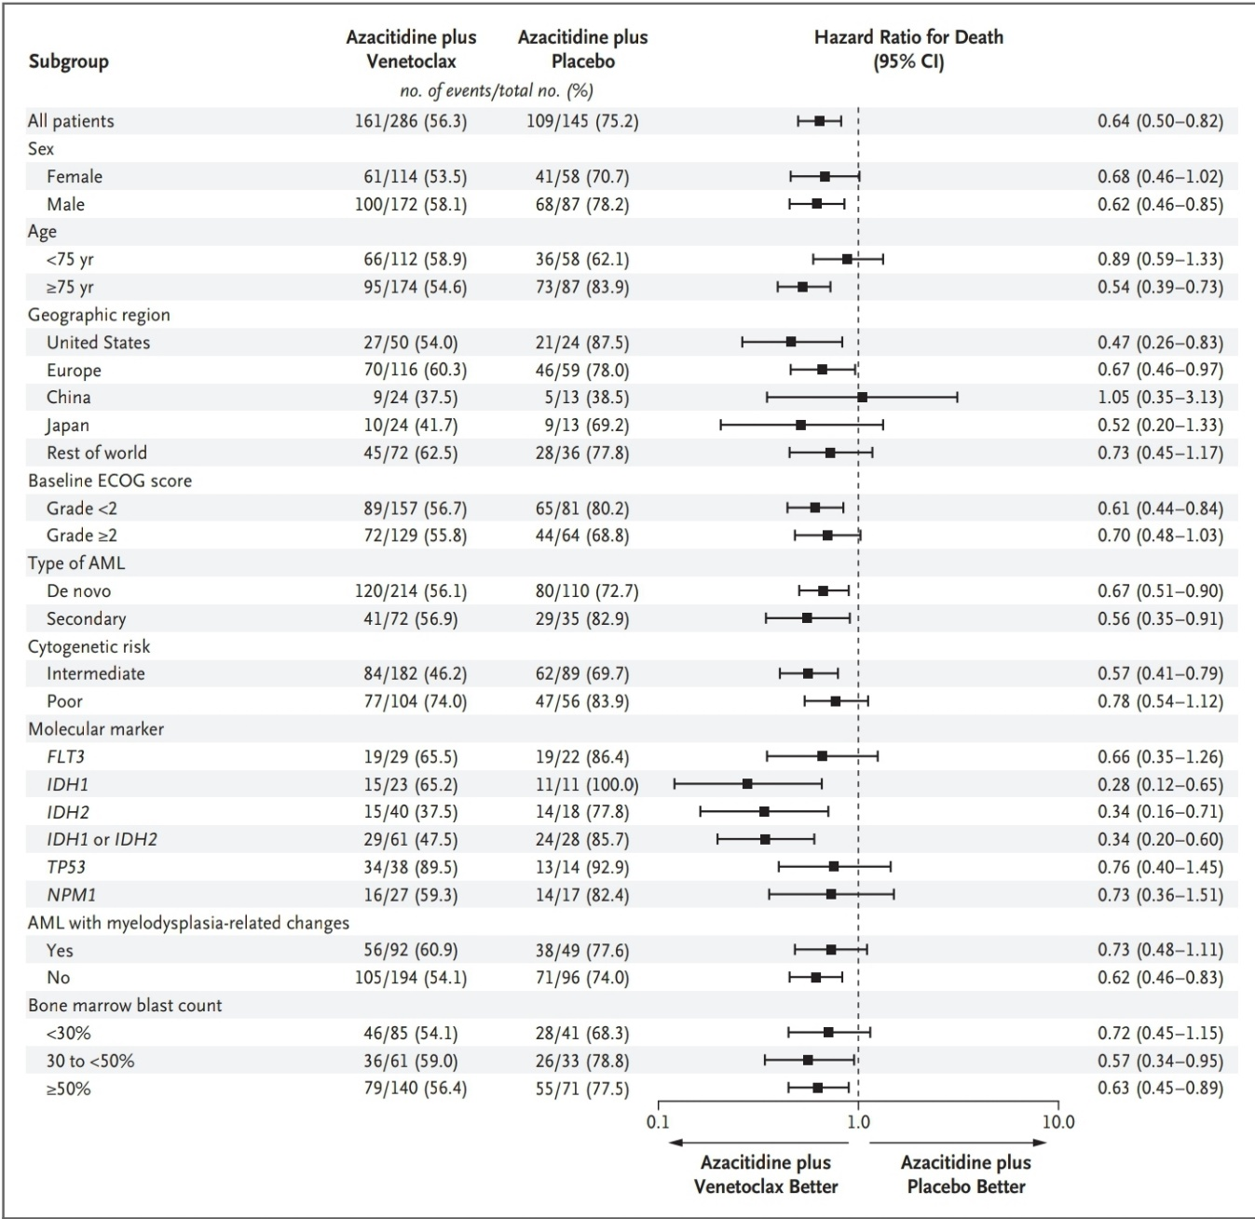
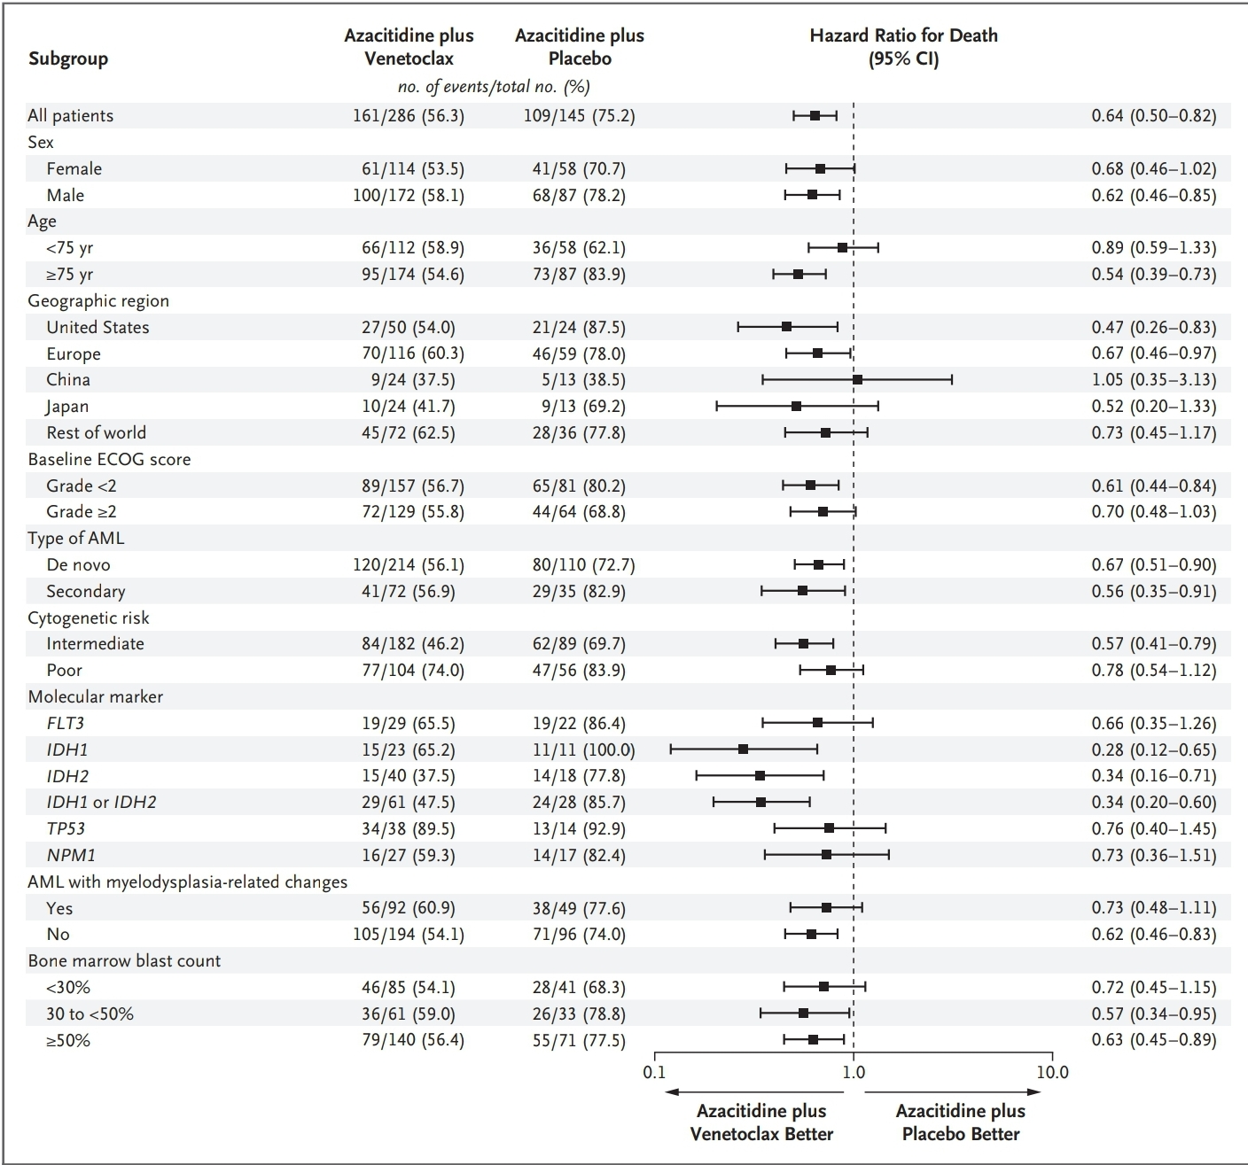
VIALE TRIAL
Subgroups analysis

Slide 13
NAÏVE PATIENTS WITH AML WHO ARE INELIGIBLE FOR INTENSIVE CHEMOTHERAPY
LOWER-INTENSITY THERAPIES
Certain molecular subsets
TP53-Mutated AML
Novel agents under investigation
APR-246:first-in-class small molecule reactivator of p53 protein function in TP53-mutant cells
Anti-CD47 macrophage checkpoint molecule magrolimab
Sallman DA, Asch AS, Kambhampati S, Al Malki M, Zeidner J. The First-in-Class Anti-CD47 Antibody Magrolimab Combined with Azacitidine Is Well-Tolerated
and Effective in AML Patients: Phase 1b Results. Presented at: 62nd ASH Annual Meeting & Exposition. Virtual; 2020. Abstract 330.
Birsen R, Larrue C, Decroocq J, et al. APR-246 induces early cell death by ferroptosis in acute myeloid leukemia. Haematologica. 2022;107:403-416.

Slide 14
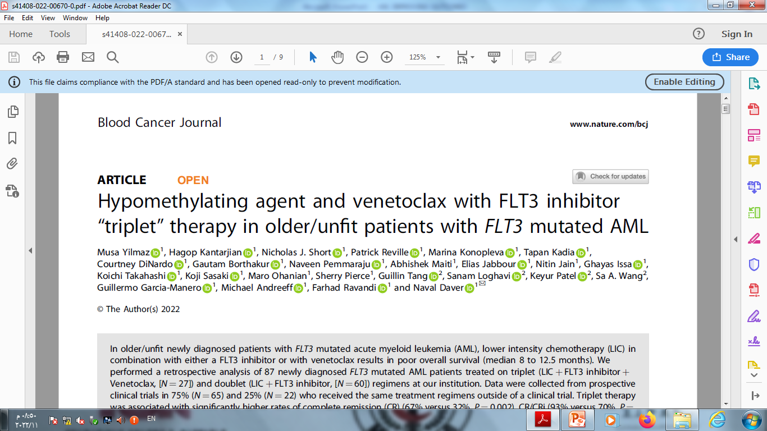
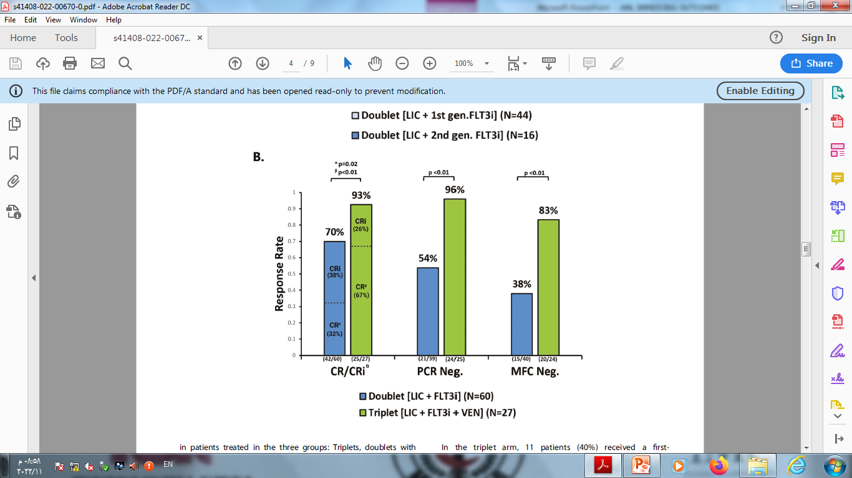
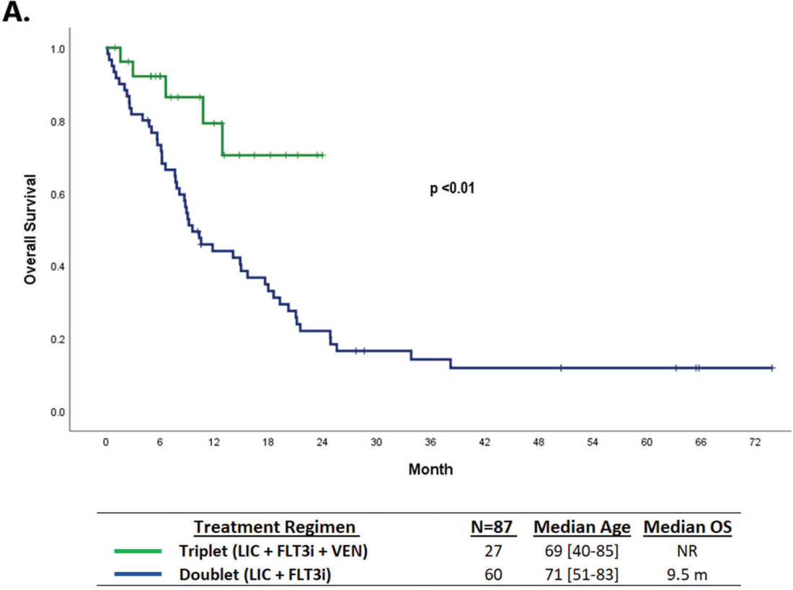
NAÏVE PATIENTS WITH AML WHO ARE INELIGIBLE FOR INTENSIVE CHEMOTHERAPY
LOWER-INTENSITY THERAPIES
Certain molecular subsets
FLT3-Mutated AML
30% of all patients with newly diagnosed AML
Blood Cancer Journal (2022) 12:77 ; https://doi.org/10.1038/s41408-022-00670-0

Slide 15
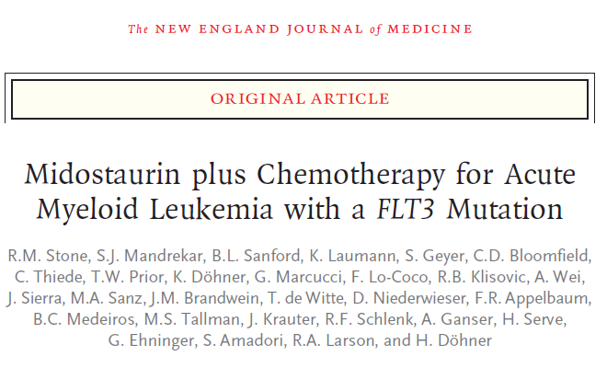
TREATMENT OF AML IN THE FRONTLINE SETTING
PATIENTS WITH AML WHO ARE ELIGIBLE FOR INTENSIVE THERAPY
FLT3-Mutated AML
FDA approval in April 2017
midostaurin in combination with intensive induction and consolidation therapy has been considered the standard of care for FLT3-mutant AML
n engl j med 377;5 nejm.org August 3, 2017

Slide 16
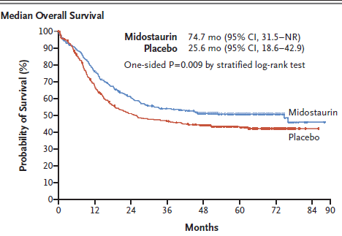
TREATMENT OF AML IN THE FRONTLINE SETTING
PATIENTS WITH AML WHO ARE ELIGIBLE FOR INTENSIVE THERAPY
FLT3-Mutated AML
(RATIFY) trial
22% lower risk of death
Median DFS
26.7 months
VERSUS
15.5 months
n engl j med 377;5 nejm.org August 3, 2017

Slide 17
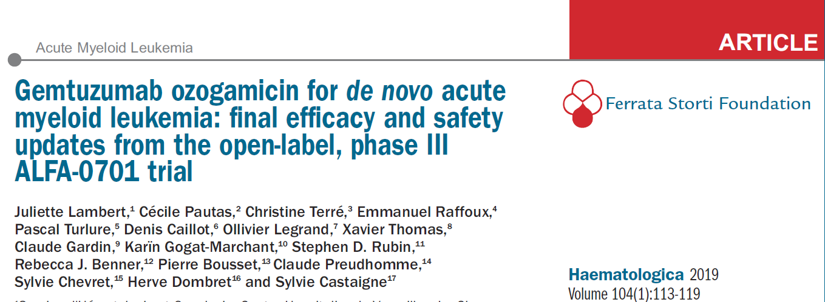
TREATMENT OF AML IN THE FRONTLINE SETTING
PATIENTS WITH AML WHO ARE ELIGIBLE FOR INTENSIVE THERAPY
FLT3-negative de novo AML
Gemtuzumab ozogamicin (GO) represents a treatment option for patients with FLT3-negative de novo AML
FDA approval in September 2017
ALFA-0701 trial

Slide 18
TREATMENT OF AML IN THE FRONTLINE SETTING
PATIENTS WITH AML WHO ARE ELIGIBLE FOR INTENSIVE THERAPY
ALFA-0701 trial
FLT3-negative de novo AML
Median RFS was 28.0 months in the GO arm and 11.4 months in the control arm
47% reduction in the risk of an event for patients in the GO arm compared with those in the control arm
haematologica | 2019; 104(1) doi:10.3324/haematol.2018.188888

Slide 19
Postremission therapy
Allogeneic HCT
Maintenance therapy

Slide 20
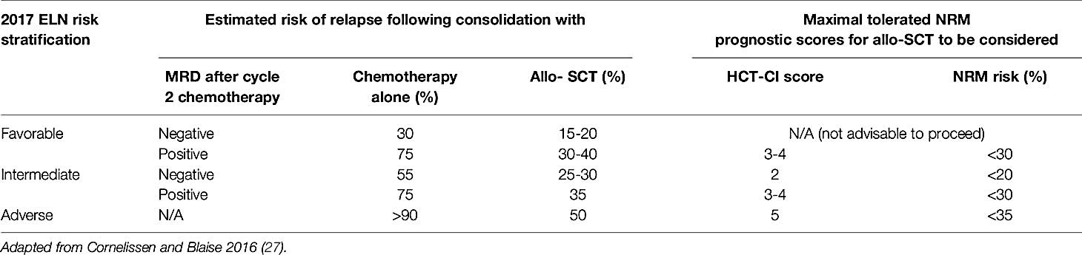
Postremission therapy
allogeneic stem cell transplantation (allo-SCT) remains centrally important in the optimal management of fit adults with AML
Allogeneic HCT should be considered when the relapse probability without the procedure is predicted to be 35% to 40%.
Loke J, Vyas H and Craddock C (2021) Optimizing Transplant Approaches and Post-Transplant Strategies for Patients With Acute Myeloid Leukemia. Front. Oncol. 11:666091.

Slide 21
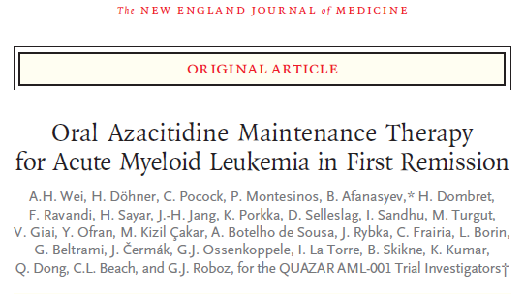
Postremission therapy
patients not able to complete intensive curative postremission therapy
oral AZA therapy was approved for
patients with AML by the FDA on September 2020

Slide 22
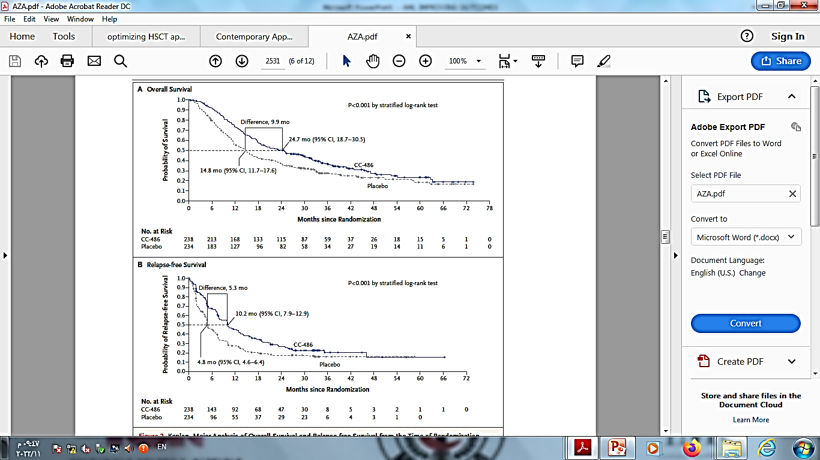
Postremission therapy
patients not able to complete intensive curative postremission therapy
N Engl J Med 2020;383:2526-37. DOI: 10.1056/NEJMoa2004444

Slide 23
RELAPSED/REFRACTORY AML
Approximately 25% to 30% of patients treated with intensive induction chemotherapy have primary refractory disease.
58.9% of patients experienced relapse at a median of 7.2 months after achieving a CR
2022 ASCO EDUCATIONAL BOOK | asco.org/edbook

Slide 24
RELAPSED/REFRACTORY AML
the dominant clone gains relapse specific mutations and, in others, a minor clone survives chemotherapy and expands at relapse
2022 ASCO EDUCATIONAL BOOK | asco.org/edbook

Slide 25
RELAPSED/REFRACTORY AML
relapse after allo-HCT is associated with downregulation of MHC class II gene expression, with a decrease in antigen presentation enabling escape from the graft-versus-leukemia effect
2022 ASCO EDUCATIONAL BOOK | asco.org/edbook

Slide 26
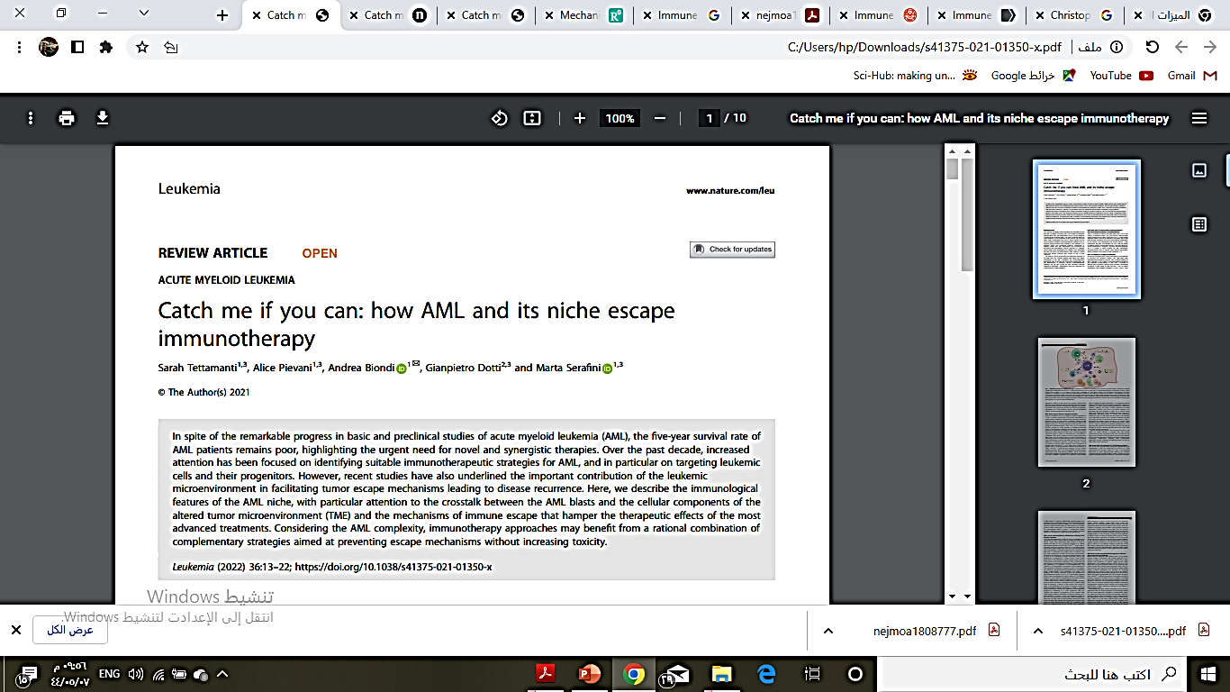
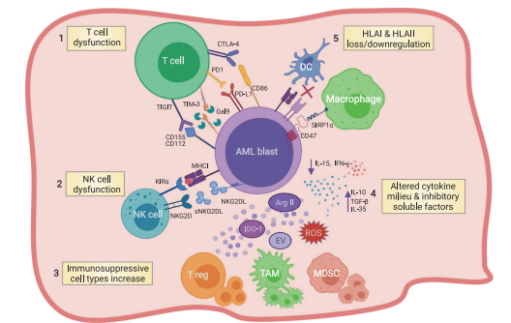
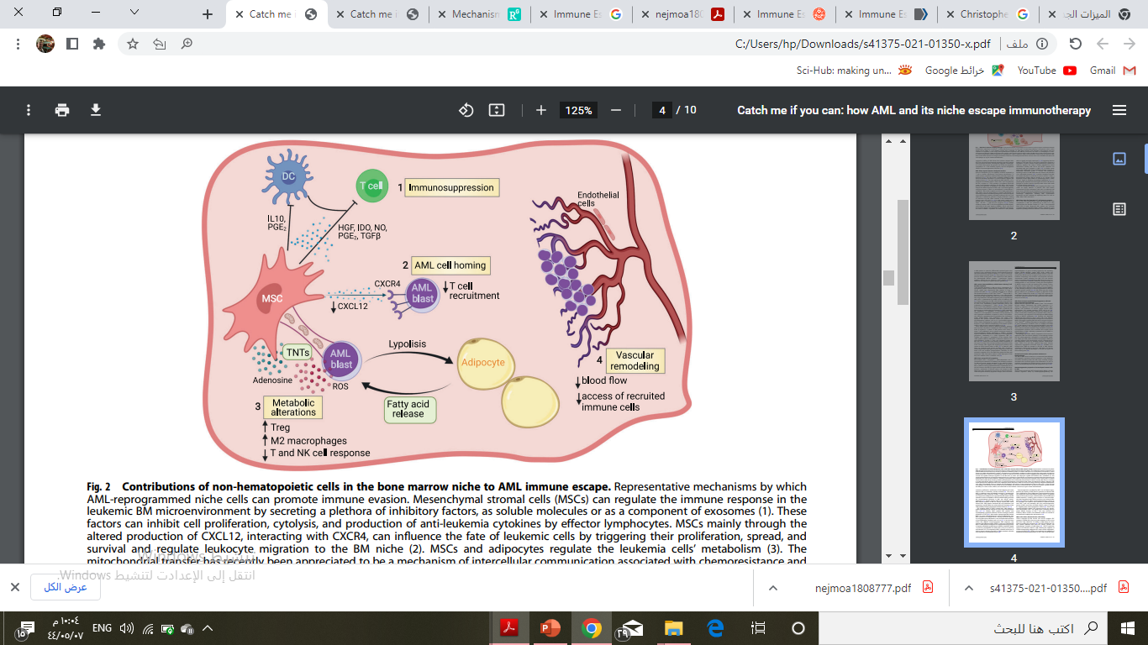
RELAPSED/REFRACTORY AML
Leukemia (2022) 36:13–22; https://doi.org/10.1038/s41375-021-01350-x

Slide 27
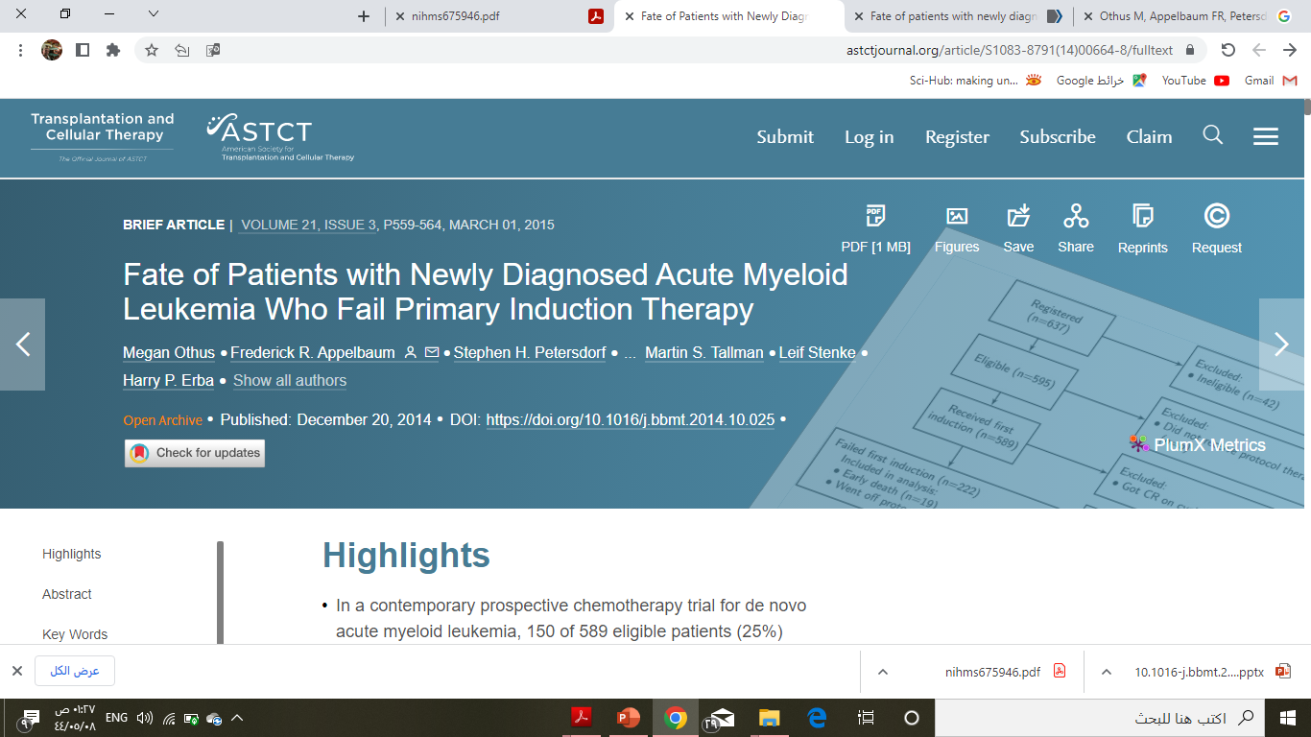
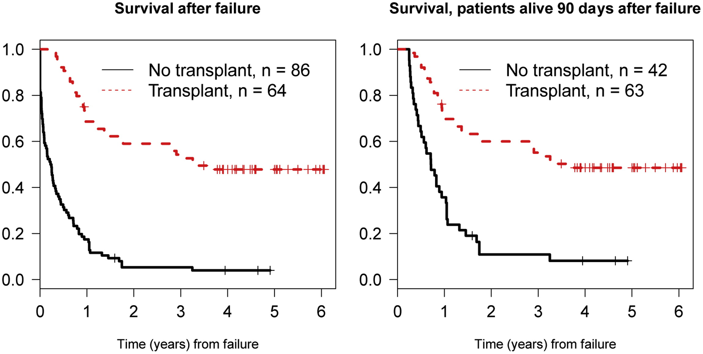
Biology of Blood and Marrow Transplantation 2015 21559-564DOI: (10.1016/j.bbmt.2014.10.025)

Slide 28
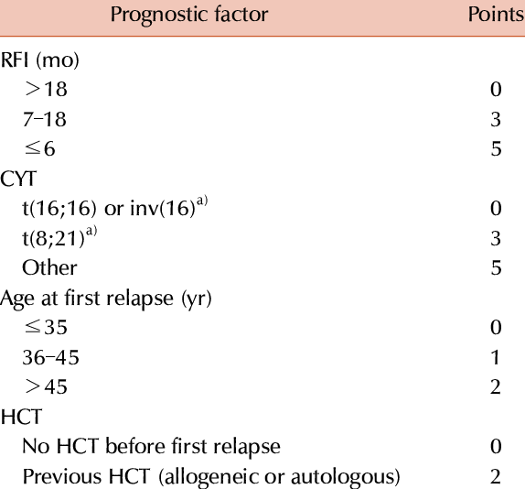
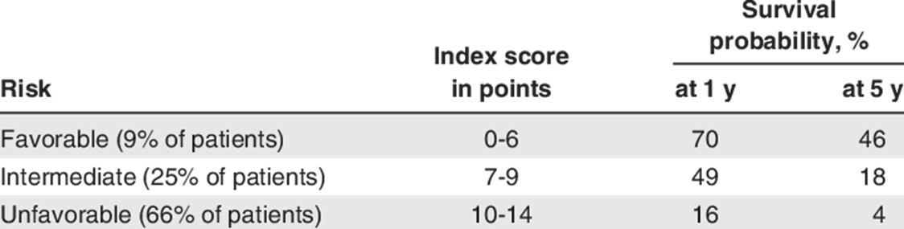
Prognostic score for AML at first relapse

Slide 29
RELAPSED/REFRACTORY AML
Hematology 2021 | ASH Education Program

Slide 30
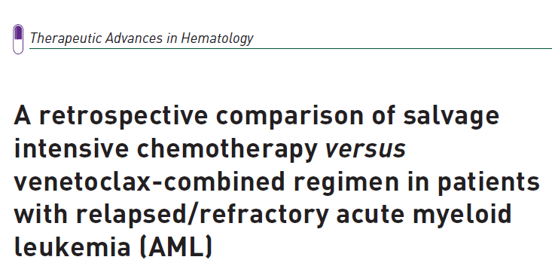
RELAPSED/REFRACTORY AML
her Adv Hematol 2022, Vol. 13: 1–17 DOI: 10.1177/20406207221081637

Slide 31
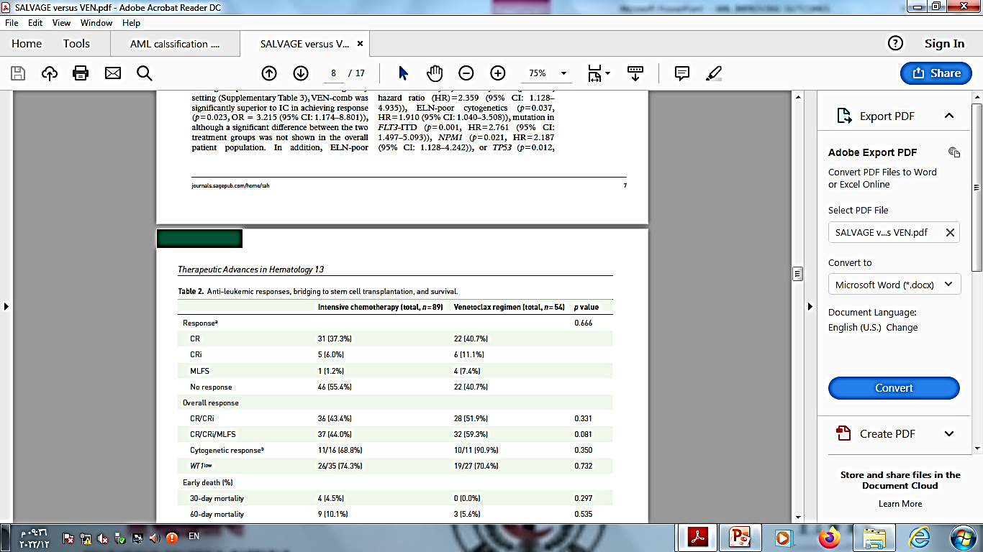
RELAPSED/REFRACTORY AML
her Adv Hematol 2022, Vol. 13: 1–17 DOI: 10.1177/20406207221081637

Slide 32
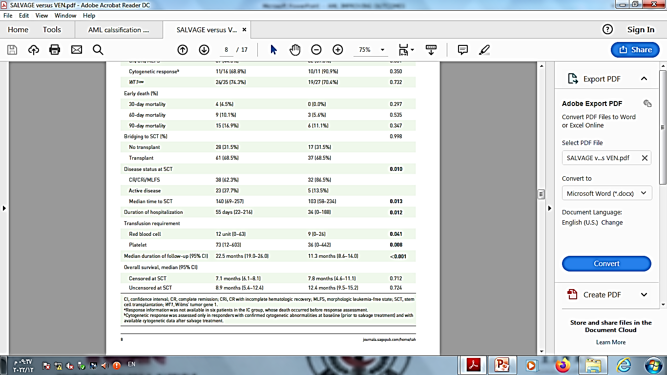
RELAPSED/REFRACTORY AML
her Adv Hematol 2022, Vol. 13: 1–17 DOI: 10.1177/20406207221081637

Slide 33
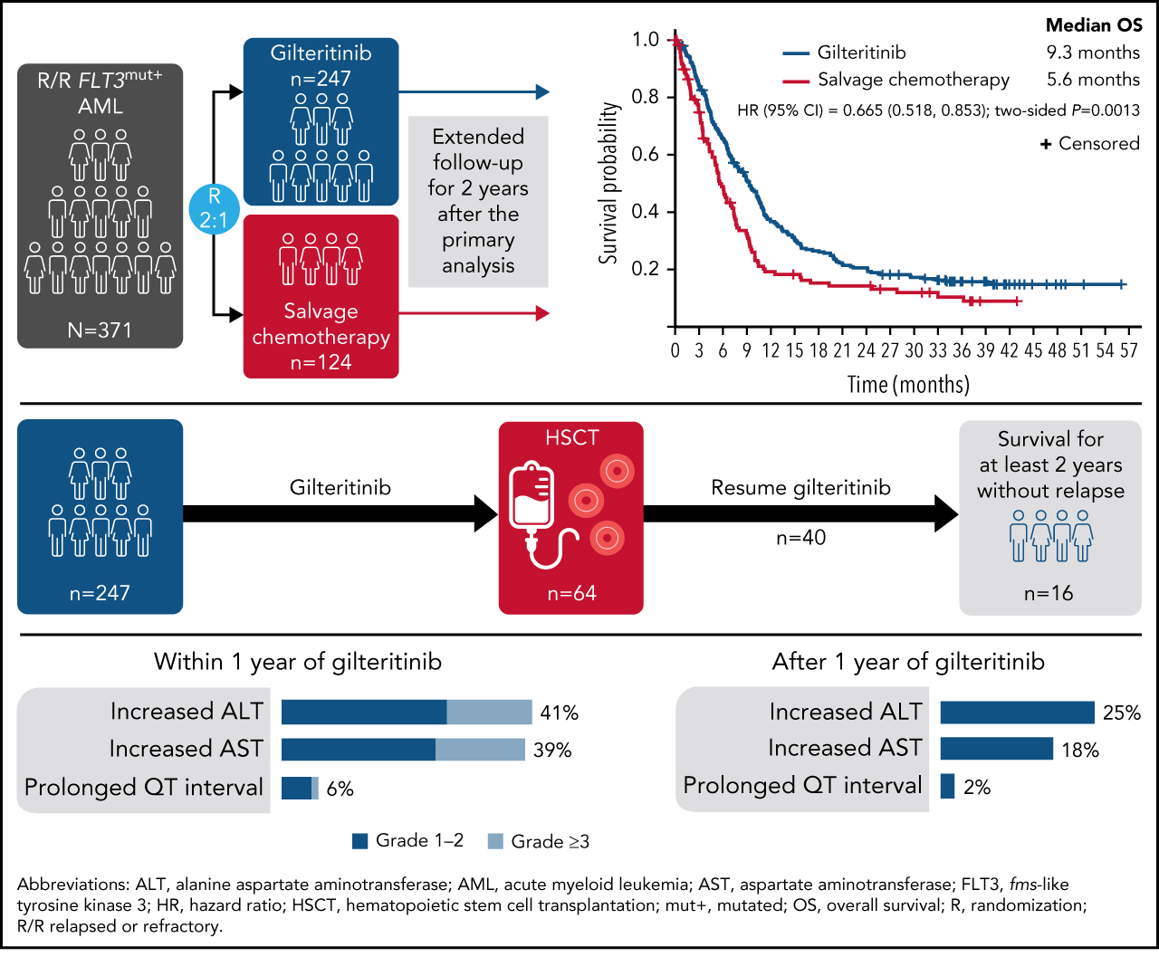

Follow-up of patients with R/R FLT3-mutation–positive AML treated with gilteritinib in the phase 3 ADMIRAL trial
Copyright © 2022 American Society of Hematology
Notes:
Figure Legend:

Slide 34
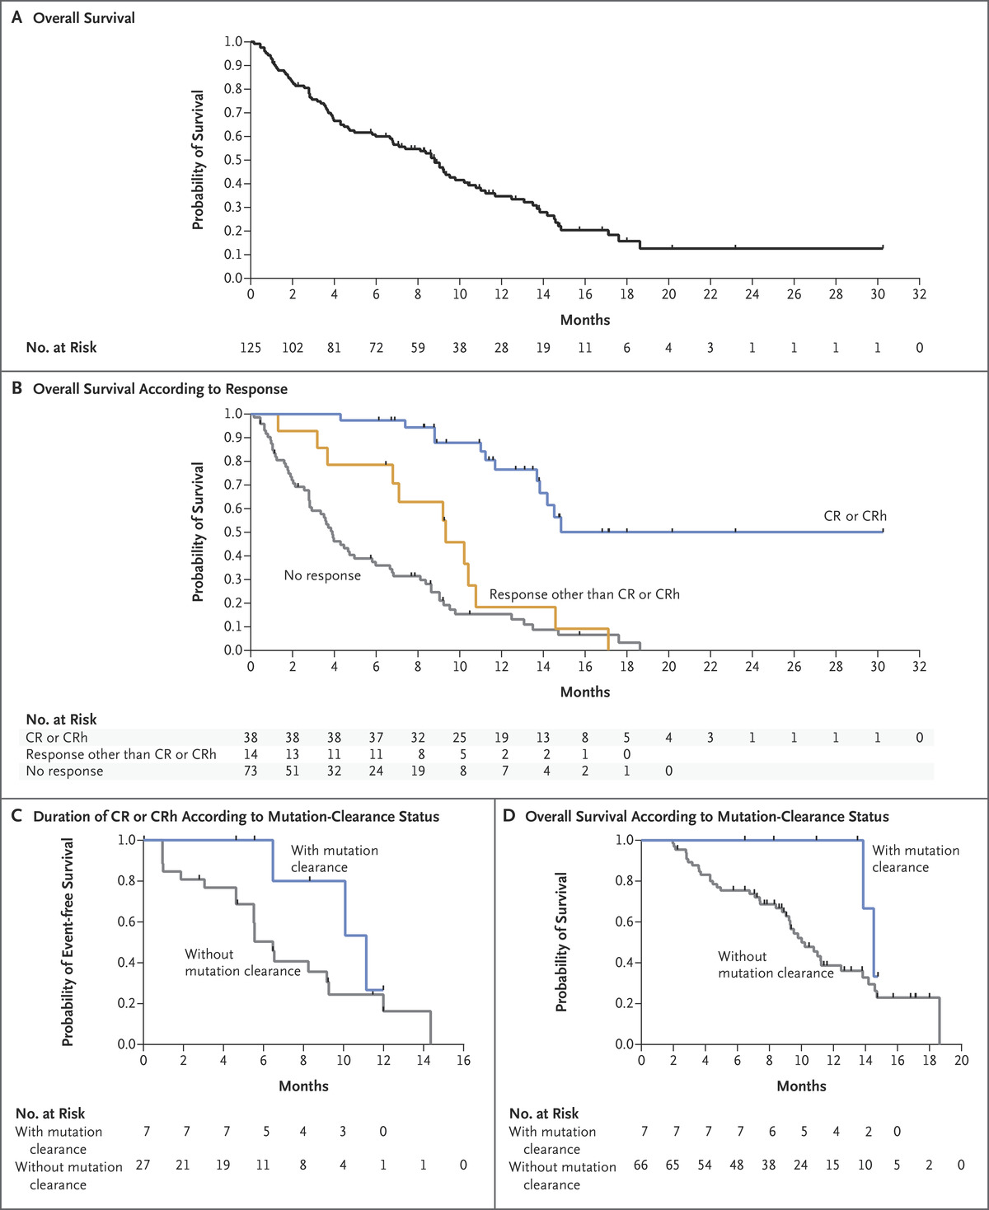

Durable Remissions with Ivosidenib in IDH1-Mutated Relapsed or Refractory AML
Overall response rate 40%
median OS of 9 months.
CD DiNardo et al. N Engl J Med 2018;378:2386-2398.
Notes:
Figure 2. Overall Survival, Response of CR or CRh, and Mutation-Clearance Status. Panel A shows overall survival in the primary efficacy population. Panel B shows overall survival according to response in the primary efficacy population. Panel C shows the duration of CR or CRh in patients with and those without clearance of IDH1 mutations. Panel D shows the duration of overall survival among patients with and those without clearance of IDH1 mutations. Data in Panels C and D are for patients in the dose-expansion phase with relapsed or refractory AML whose starting dose of ivosidenib was 500 mg once daily and who received the first dose at least 6 months before the analysis-cutoff date. Tick marks indicate censored data.

Slide 35
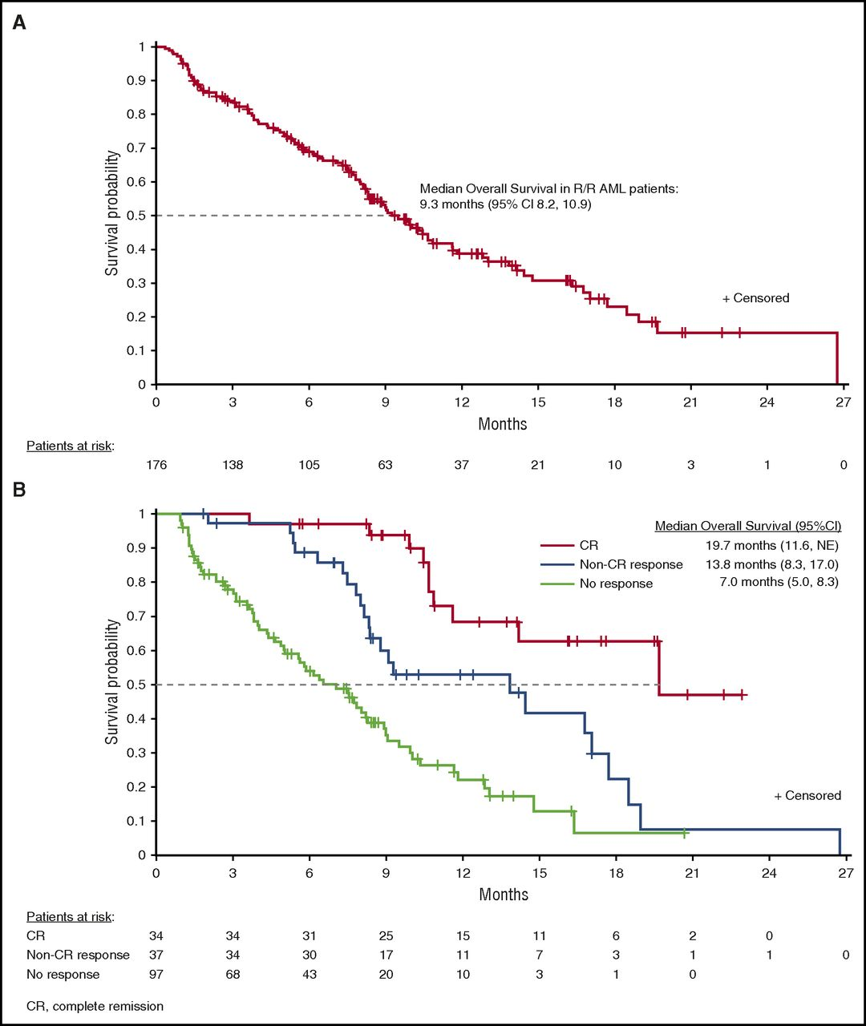
Enasidenib in mutant IDH2 relapsed or refractory acute myeloid leukemia
Overall response rate 40%
median OS of 9 months.
Copyright © 2022 American Society of Hematology
Notes:
Figure Legend:
Overall survival. (A) Overall survival among all patients with relapsed/refractory (R/R) AML. (B) Overall survival among patients with relapsed/refractory AML in complete remission (CR), patients with a non-CR hematologic response, or no response. NE, not evaluated.

Slide 36
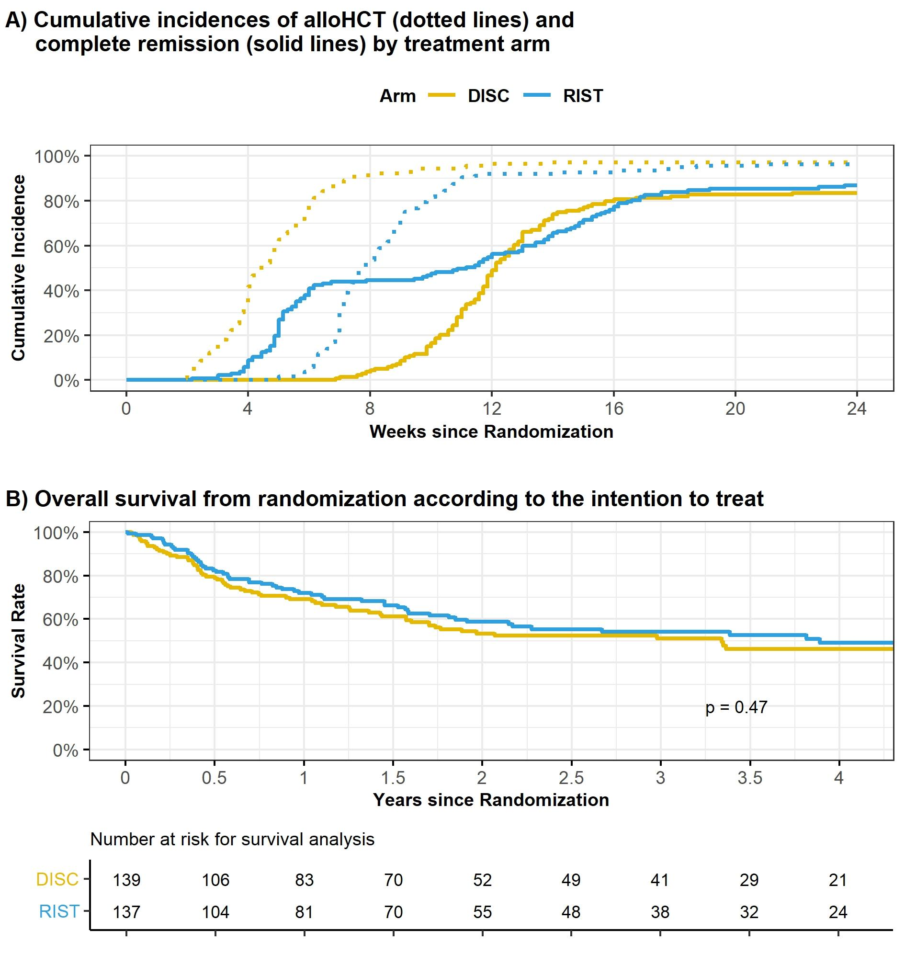
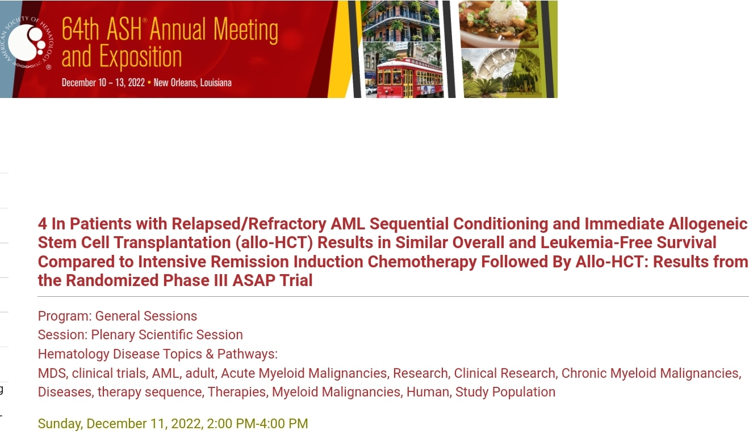
Dose intensive remission induction CT prior to alloHCT really improve outcome compared to immediate alloHCT after sequential conditioning without attempt to induce a CR before transplantation ?
Median time for allSCT 4W in DISC, 8W in RIST
After 24 w 98% reach alloSCT in DISC , 96% IN RIST
OS 1 y 69% in DISC , 71% IN RIST
OS 3 y 51% in DISC , 54% IN RIST

Slide 37

Thank you for Listening...

